Slide 1

FINAL DEFENSE
Barangay Vehicle Management System
Keeping emergency response vehicles ready, repaired and accountable
Capstone Project | October 2026
Notes:
Introduce the project: a web-based system that tracks readiness and maintenance of the barangay's emergency vehicles.

Slide 2
02 INTRODUCTION
Project overview
A web-based system that tracks whether each barangay emergency vehicle (ambulance, fire truck, rescue boat and others) is ready to respond, and manages the repair process that keeps it that way, from reported issue to verified return to service.
2
questions it answers
Can this vehicle be dispatched now? What keeps it serviceable?
3
user roles
Admin, Custodian and Maintenance Personnel
Built as a Laravel REST API with a React single-page app.
2
repair routes
In-house mechanic or external repair shop

Slide 3



03 THE PROBLEM
Problem statement
Emergency vehicles are used only when disaster strikes, yet the barangay cannot say, with proof, which of them can respond right now, or who is responsible for fixing the ones that cannot.
No single view of readiness
Issues are reported informally
Availability and condition are scattered across memory, chats and paper logs.
Verbal reports get lost, carry no severity or evidence, and are never tracked to closure.

Slide 4
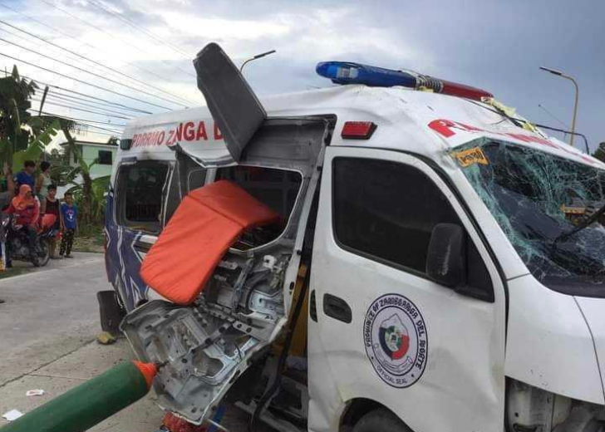
03 THE PROBLEM (1 OF 2)
Problem statement: the evidence
1 in 3
Filipinos view poor maintenance of vehicles as a primary cause of road accidents (33% of 1,418 respondents).
Poor vehicle maintenance is a safety risk to the public, and for emergency units it is also a risk to the people they are sent to save.
An emergency responder died and three others were injured when their ambulance rolled over after it blew a tire on the national highway in Argao, Cebu (June 13).
Sources: Cebu Daily News, "Argao ambulance accident: emergency responder dead, 3 others hurt" (photo: Argao MDRRMO via Paul Lauro). WR Numero Research, Philippine Public Opinion Monitor, Issue 4, Vol. 2025 (n = 1,418; 29 Jul to 6 Aug 2025; margin of error ±2%).
Notes:
Sources: cebudailynews.inquirer.net/578615/argao-ambulance-accident-emergency-responder-dead-3-others-hurt ; WR Numero Philippine Public Opinion Monitor, Issue 4 Vol 2025.

Slide 5
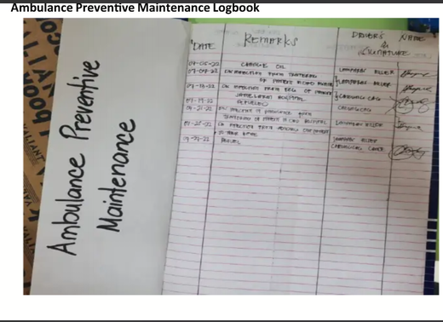
03 THE PROBLEM (2 OF 2)
Problem statement: the evidence
"Many of the vehicles are so unserviceable that they are unsafe to use."
Cebu City Mayor Tomas Osmeña, on the recall of several barangays' vehicles for inventory, inspection and repair (SunStar Cebu)
OFFICIAL STATEMENT, PROVINCE OF CEBU
"When I came in, there were only 10 personnel and only three responders. The vehicles were not running, and we had a very dilapidated office."
Preventive maintenance today: a handwritten logbook of dates, remarks and signatures.
Ret. Col. Dennis Francis Pastor, head of the Provincial Disaster Risk Reduction and Management Office (PDRRMO), on iStorya Cebu, May 22. Report: "inheriting limited manpower, non-operational vehicles, and inadequate facilities." Source: Capitol PIO, cebu.gov.ph
Sources: SunStar Cebu, "Safety, not politics behind recall of vehicles"; Province of Cebu, "PDRRMO highlights Gov. Pam Baricuatro's disaster preparedness programs, strategic warehouses in Cebu" (cebu.gov.ph); ambulance preventive maintenance logbook photo.
Notes:
Sources: sunstar.com.ph/cebu/local-news/safety-not-politics-behind-recall-of-vehicles ; cebu.gov.ph/12653/pdrrmo-highlights-gov-pam-baricuatros-disaster-preparedness-programs-strategic-warehouses-in-cebu/

Slide 6

04 WHAT THE SYSTEM SOLVES
Proposed solution
The VMS replaces guesswork with one controlled workflow: every vehicle has a clear status, and every repair has an owner, an approval and proof.
PROBLEM
HOW THE VMS SOLVES IT
Which vehicles can respond now?
Availability and condition tracked separately, with a readiness dashboard and condition monitoring
Issues get lost
Structured issue reports with vehicle, severity and evidence, turned into maintenance tickets

Slide 7






05 GOALS
Project objectives
General objective Design and build a web-based system that keeps barangay emergency vehicles ready to respond through managed maintenance.
Maintain a fleet inventory
Track readiness
Run a controlled ticket workflow
Vehicle profiles, types, documents and station locations
Availability and condition per vehicle, with fleet intelligence
Report, propose, approve, repair, verify, close
Schedule preventive maintenance
Enforce roles and an audit trail
Report and notify
Recurring schedules and maintenance records
Role-based access, separation of duties, activity log
Reports, notifications and archived tickets

Slide 8


06 BOUNDARIES
Scope and delimitations
In scope
Delimitations (out of scope)
Fleet inventory and vehicle profiles
Availability and condition, tracked independently
Issue reporting, tickets, repairs, verification, closure
Preventive and recurring maintenance schedules
Readiness checks and fleet intelligence
Vehicle station locations (hubs)
Operations and dispatch
Who drove where on a call is not recorded.
Document compliance
Registration, insurance and permit expiry are not tracked.
Mileage-based servicing
Odometer readings do not drive maintenance.
Real-time GPS tracking
Only the station (hub) of each vehicle is recorded.
Native mobile apps
The system is web-based only.

Slide 9



07 WHO USES IT
Target users
Admin
Custodian
Maintenance Personnel
Approves or declines proposed tickets
Assigns and reassigns personnel
Manages fleet, accounts and reports
Confirms the repair route and reassigns when needed
Reports issues and registers vehicles
Proposes tickets and sends vehicles to the external shop
Verifies the completed repair independently
Monitors vehicle condition
Executes assigned repairs
Logs work performed and parts used
Submits work orders for verification
Reports technical issues

Slide 10
08 PROCESS
Ticket flow: in-house and external shop
1 Report issue
Custodian, with severity and evidence
2 Propose ticket
Custodian picks route and repair lines
3 Admin review
Approve, or decline with reason
Approved: repair route set at proposal
IN-HOUSE
Custodian suggests a mechanic; Admin confirms or reassigns
Mechanic repairs, logs work and parts
Custodian verifies the completed repair
4 Outcome
Satisfactory: ticket closes. Not satisfactory: rework
EXTERNAL SHOP
Admin approves the shop repair
Custodian sends the vehicle to the shop; it is returned
Custodian verifies the returned vehicle
Disapproved returns the ticket for rework with a reason. Whoever repaired or handled the work cannot verify it.
Closed and archived
Notes:
Walk through the shared steps first, then the two repair routes, then verification and closure.

Slide 11

09 REQUIREMENTS
Use case diagram
Diagram to be attached
Shows how Admin, Custodian and Maintenance Personnel interact with the system.

Slide 12

10 DESIGN
System architecture diagram
Diagram to be attached
Shows the React single-page app, Laravel REST API, database and cloud storage.

Slide 13

11 DATA
Entity relationship diagram
Diagram to be attached
Shows the vehicles, issues, tickets, repairs, schedules and users tables and how they relate.

Slide 14
12 LIVE DEMONSTRATION
Demo: the core workflow
Custodian reports an issue and sets a maintenance schedule
CUSTODIAN
1
In-house or sent to an external shop
Admin approves the ticket
ADMIN
2
Confirms the repair route
Maintenance personnel performs the repair
MAINTENANCE
3
Logs work and parts used
Custodian verifies the work and closes the ticket
CUSTODIAN
4
Satisfactory: closed and archived. Otherwise: rework
Thank you. Questions?
Setup steps (barangay registration, accounts, vehicle) are in the complete demo workflow PDF.

